Slide 1
Real-Time IoT Data Streaming Pipeline with Integrated Quality Monitoring and Anomaly Detection
TOPIC
Jyothssena Gomatum Sreenivaasan
Jay Jajoo
Asmita Chetlapalli

Slide 2
INTRODUCTION
Overview:
With the increasing deployment of IoT devices across industries, vast amounts of real-time sensor data are being generated. To make this data actionable, it is crucial to implement a robust data streaming pipeline that ensures data quality and detects anomalies.

Slide 3
OBJECTIVE
To design and implement a real-time data streaming pipeline for IoT sensor data that integrates data quality monitoring and anomaly detection. The pipeline will ensure reliable and accurate data processing, enabling efficient decision-making in IoT applications.

Slide 4
GOALS
Detect Anomalies in Real-Time:
Flag unusual sensor data patterns for timely intervention
Build a Scalable Real-Time Data Pipeline:
Efficiently process continuous IoT sensor data.
Ensure Data Quality and Integrity
Monitor data for completeness, consistency, and accuracy.

Slide 5
PROJECT SCOPE
Real-Time Data Ingestion: Efficiently process continuous IoT sensor data.
Data Quality Monitoring: Ensure data completeness, consistency, and accuracy.
Anomaly Detection: Identify and flag unusual sensor data patterns in real-time.
Scalability: Design the pipeline to handle large data volumes with low latency.

Slide 6
LITERATURE REVIEW

Slide 7
A Comprehensive Review of Machine Learning Approaches for Anomaly Detection in Smart Homes: Experimental Analysis and Future Directions
Authors: Md Motiur Rahman, Deepti Gupta, Smriti Bhatt, Shiva Shokouhmand and Miad Faezipour,
Dataset : ARAS Dataset
Models : k-fold cross validation followed by LSTM and GRU
Results : Gated Recurrent Unit (GRU) outperformed the other
Cons : Created anomalies before classification by using third party resources for anomaly detection.

Slide 8
2. LSTM-Autoencoder-Based Anomaly Detection for Indoor Air Quality Time-Series Data
Authors: Yuanyuan Wei, Julian Jang-Jaccard, Wen Xu, Fariza Sabrina, Seyit Camtepe, Mikael Boulic
This study addresses indoor air quality (IAQ) monitoring challenges, focusing on detecting anomalies in CO2 data from schools, which affect student health and productivity. Traditional methods like ARIMA and KNN have limitations, while AI-based approaches often require multiple correlated data points. The proposed hybrid deep learning model combines Long Short-Term Memory (LSTM) and autoencoder (AE) to enhance anomaly detection in time-series data by extracting features, reconstructing data, and calculating reconstruction error for threshold-based detection. Tested on real-world CO2 datasets, the model demonstrates high accuracy (99.50%), precision (100%), and robust anomaly detection.

Slide 9
2. HomeGuardian: Detecting Anomaly Events in Smart Home Systems
Authors: Dai Xuan, Mao Jian, Li Jiawei, Lin Qixiao, Liu Jianwei
This paper presents HomeGuardian, a context-based approach for detecting anomalies in smart home environments. The system leverages both temporal and environmental contexts extracted from system logs to identify abnormal events. By embedding these hybrid contexts into a learning-based classifier, HomeGuardian can effectively detect anomalies. The approach is tested on a dedicated testbed, demonstrating its potential in enhancing security by identifying unusual patterns indicative of security threats.

Slide 10
METHODOLOGY

Slide 11
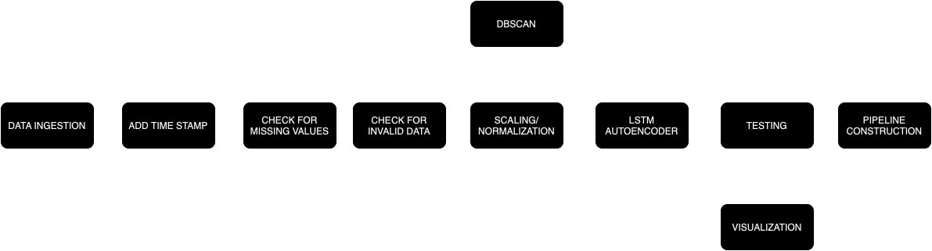
Project Workflow …

Slide 12
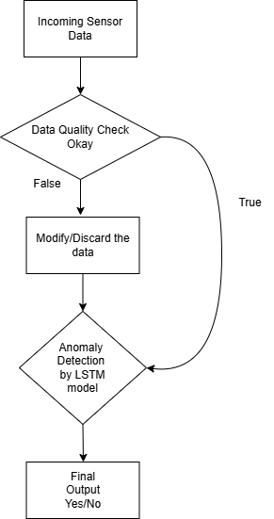
How Pipeline Works?

Slide 13
TECHNIQUES USED
DBscan
LSTM AutoEncoder

Slide 14
DB SCAN
(Density-Based Spatial Clustering of Applications with Noise)
DBSCAN groups data points into clusters based on their density, defined by two parameters: epsilon, which specifies the radius of the neighborhood around a data point, and MinPts, the minimum number of points required to form a dense region.
Anomaly Detection: Anomalies are detected as noise points that do not fit into any dense cluster. This makes DBSCAN particularly useful for identifying anomalies in datasets where outliers are not clearly defined or may be embedded within clusters.

Slide 15
LSTM AutoEncoder
An LSTM Autoencoder is composed of two main components: an Encoder and a Decoder.
Encoder: This part compresses the input sequence into a smaller latent space representation. It captures the most important features of the input data by learning temporal patterns.
Decoder: The Decoder reconstructs the input sequence from the compressed representation. The goal is to make the reconstructed output as similar as possible to the original input.

Slide 16
Reconstruction Error: After training, the model is used to reconstruct new sequences. The reconstruction error (the difference between the input and its reconstruction) is calculated for each sequence.
Threshold Setting: A threshold for reconstruction error is established based on the maximum error observed in the training data. This threshold helps distinguish between normal and anomalous sequences.
Anomaly Identification: If the reconstruction error for a new sequence exceeds this threshold, it is flagged as an anomaly. In a smart home system, this could indicate unusual activity or potential faults in devices

Slide 17
Pseudocode
Initialize LSTM parameters:
- Input size (I)
- Hidden size (H)
- Output size (K)
- Weight matrices: Wf, Wi, Wo, Wc (for forget, input, output gates, and cell state)
- Bias vectors: bf, bi, bo, bc
Define LSTM cell function:
Input: x_t (input at time t), h_prev (previous hidden state), c_prev (previous cell state)
1. Compute forget gate: f_t = sigmoid(Wf * [h_prev, x_t] + bf)
2. Compute input gate:
i_t = sigmoid(Wi * [h_prev, x_t] + bi)
c_tilde = tanh(Wc * [h_prev, x_t] + bc)
3. Update cell state:
c_t = f_t * c_prev + i_t * c_tilde
4. Compute output gate:
o_t = sigmoid(Wo * [h_prev, x_t] + bo)
5. Compute new hidden state:
h_t = o_t * tanh(c_t)
Output: h_t (new hidden state), c_t (new cell state)
Initialize hidden state h_0 and cell state c_0 to zero
For each time step t in the sequence:
- Pass the input x_t along with the previous hidden and cell states through the LSTM cell
- Update h_prev and c_prev with the outputs h_t and c_t from the LSTM cell
Return final output based on the application (e.g., classification or regression task)

Slide 18
Time Complexity
The time complexity of an LSTM network is primarily determined by the number of weights in the network. For an LSTM, the computational complexity is O(W), where W is the total number of weights in the network. Specifically, for an LSTM, this can be calculated as:
W=4IH+4H²+3H+HK
where:
I is the number of input features,
H is the number of hidden units,
K is the number of output units.

Slide 19
Time Complexity
Total Complexity for LSTM Autoencoder
If both the encoder and decoder have the same structure : 2×(4IH+4H^2+3H+HK).
Implications for Time Complexity
The computational complexity for the forward and backward pass during training scales with O(W). Since W is dominated by H^2 for larger hidden layers (H), the time complexity for an LSTM autoencoder can be approximated as: O(T⋅H^2)
where T is the sequence length and H is the number of hidden units. This assumes I and K are relatively small compared to H.

Slide 20
Data Structures Utilized
Matrices and Vectors: Weights and biases in LSTMs are typically stored in matrices and vectors. These structures facilitate efficient computation of linear transformations and activations.
Tensors: Input data and intermediate computations are often represented as tensors, which are multi-dimensional arrays. This allows LSTMs to handle sequences of data efficiently, especially when using frameworks like PyTorch.
Lists: During training, sequences of data are often stored in lists to facilitate batch processing and sequence management.

Slide 21
ANALYSIS
AND
RESULTS

Slide 22
Time spent by week per person = 4 hrs Total time spent by 3 members = 12hrs
Time spent by each person in a week= 16 hrs
Time spent by each person in a month = 48hrs
Time Spent On Project

Slide 23
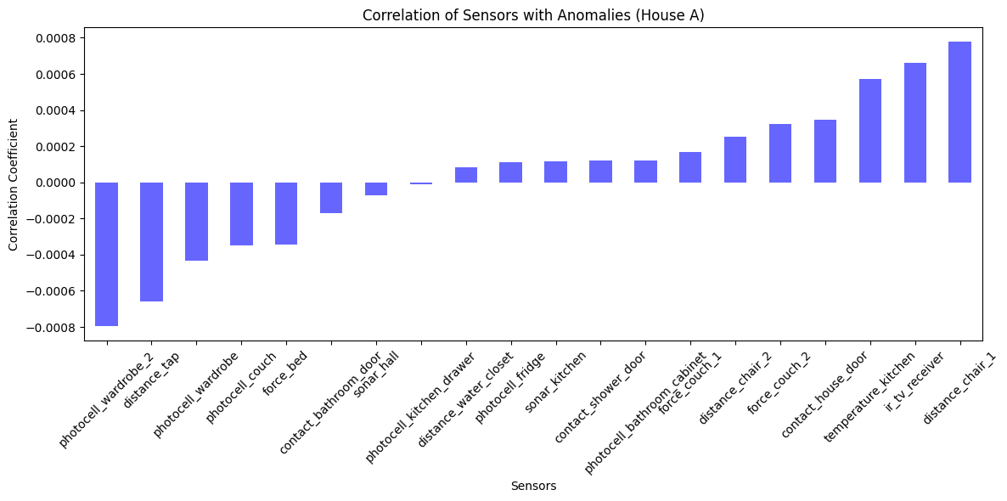
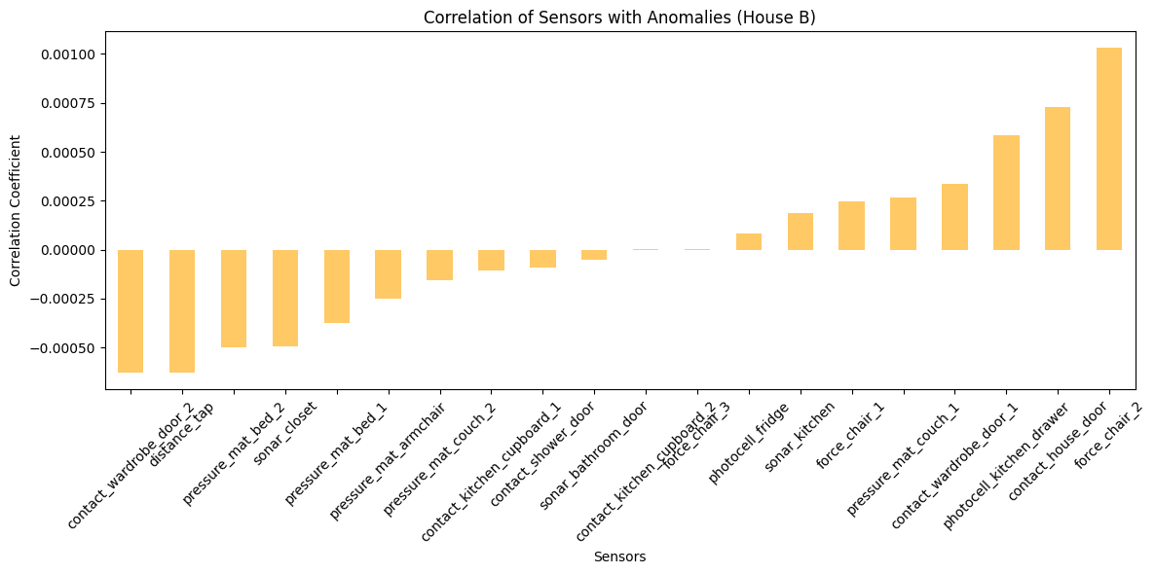
Key Findings Presentation
The individual sensors aren’t a big factor contributing to anomalies; it’s a combination of sensors values, hours, week and Day of the Week that’s contributing to the anomaly.

Slide 24
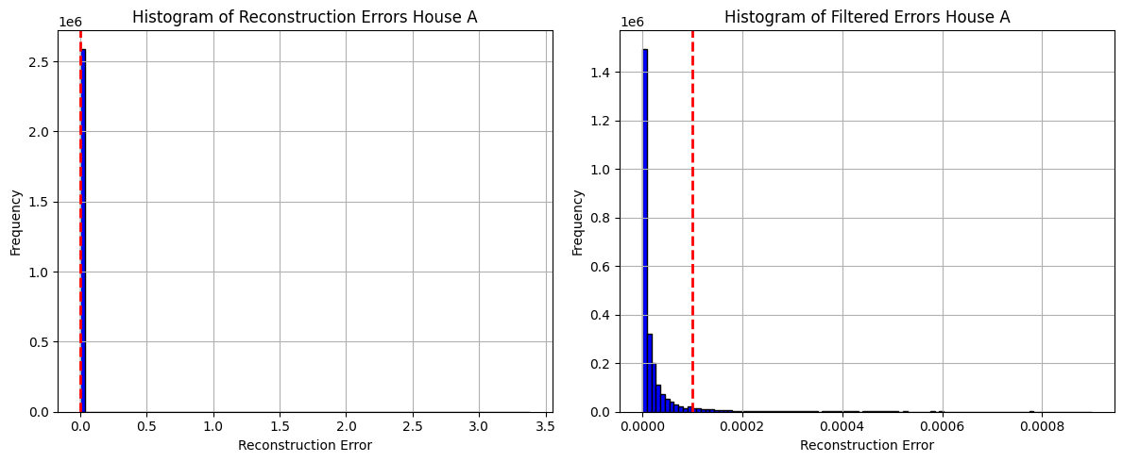
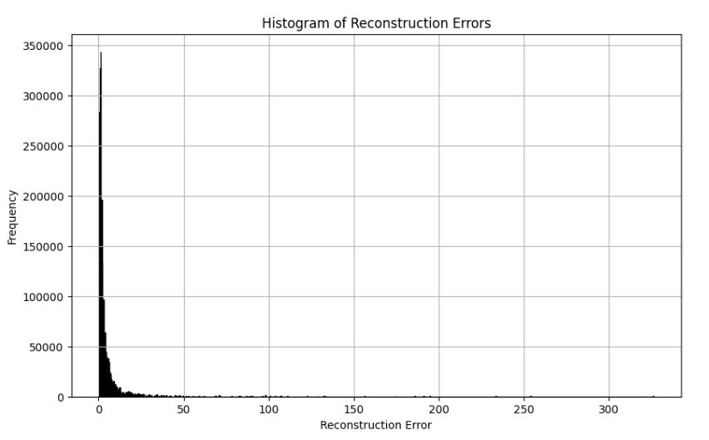
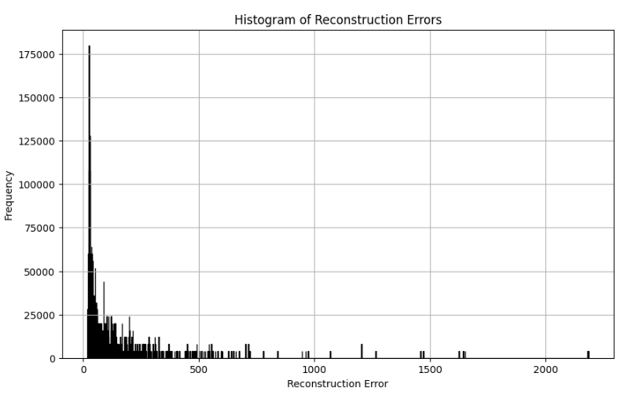
Effects of Changes in Parameters
1. Seq_len = 1 and BS = 2^17
2. Seq_len = 600 and BS=1024
3. Seq_len = 4000 and BS = 256
The above graphs are for house A threshold values obtained by training LSTM models with different parameters and, as it can be seen that more the batch size the model performs better as increasing the sequence length makes model perform worse as it giving more higher threshold values.

Slide 25
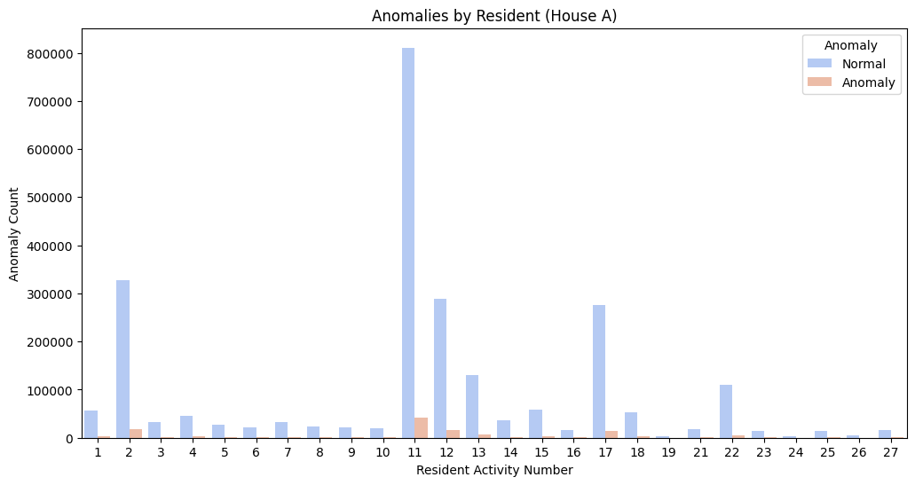
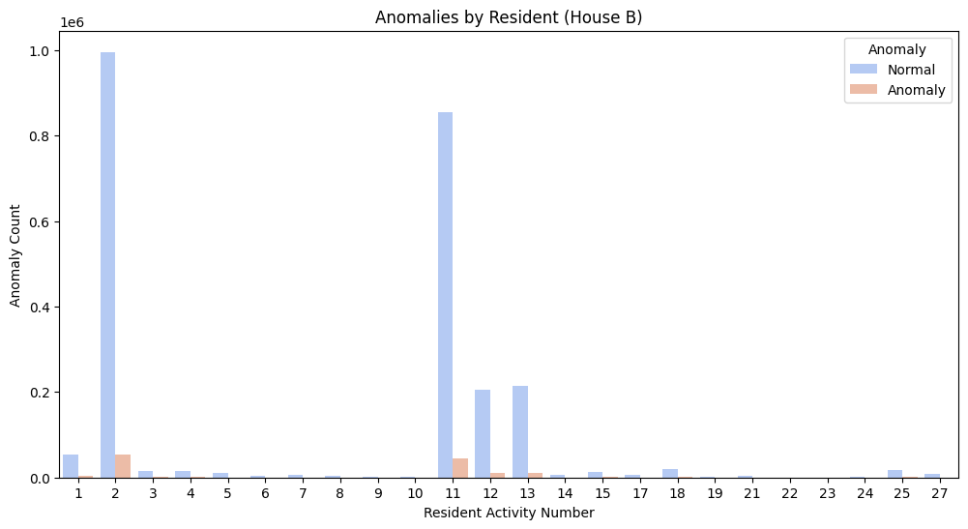
Anomaly Count Corresponding to Resident Activities
For both House A and B , the maximum anomalies were detected during activity like going out, sleeping, watching TV, studying, and while using internet.

Slide 26
DISCUSSION

Slide 27
Project Limitations
Complexity in Anomaly Detection: Difficult to handle edge cases and ensure 100% detection accuracy.
Dependency on Infrastructure: Real-time processing may require high-performance hardware and reliable network connections.
Scalability Constraints: Performance may degrade under extreme data loads without advanced optimization.
Domain-Specific Customization: Anomaly detection may need additional tuning for different IoT applications or industries.

Slide 28
Implications of Findings
Improved Data Reliability: Ensures IoT applications operate on accurate and consistent sensor data.
Proactive Issue Resolution: Real-time anomaly detection enables quick identification and resolution of data irregularities.
Scalable IoT Solutions: Demonstrates how to efficiently manage growing IoT data streams in real time.
Foundation for Advanced Analytics: Establishes a robust data pipeline for future applications like predictive maintenance and AI-driven insights.

Slide 29
CONCLUSION

Slide 30
CONCLUSION
This project developed a real-time data streaming pipeline for IoT sensor data, integrating data quality monitoring and anomaly detection to provide reliable insights. While demonstrating scalability and efficiency under typical workloads, the pipeline's performance may vary with extreme data volumes or specific domain requirements. Despite these limitations, the project establishes a strong foundation for enhancing data reliability and supporting proactive decision-making in IoT systems across various industries.

Slide 31
RECOMMENDATION FOR FUTURE
The anomalies could be labelled and a classification model could be created for the same
Anomalies can help narrow down hardware malfunctions

Slide 32
REFERENCES
https://onlinelibrary.wiley.com/doi/10.1155/2022/8022033
https://www.researchgate.net/publication/379977751_A_Comprehensive_Review_of_Machine_Learning_Approaches_for_Anomaly_Detection_in_Smart_Homes_Experimental_Analysis_and_Future_Directions
https://ieee-sensorsalert.org/articles/lstm-autoencoder-based-anomaly-detection-for-indoor-air-quality-time-series-data/

